Slide 1

Master of Computer and Information Sciences
Research Methods:
Experimental Design

Slide 2

Objectives
At the end of this session, you should be able to:
  describe the concepts and principles underlying experimental research
  understand the difference between internal and external validity in experimental design
  choose appropriately from the different types of experimental design

Slide 3
Innovation through Experimentation
Pharmaceutical’s industry – personalised drugs through use of innovative techniques from Bioinformatics
Use of simulation by BMW
Honda’s penetration of US market –
  “Many people dream of success. Success can only be achieved through repeated failure and introspection. Success represents the 1 percent of your work that results from the 99 percent that is called failure." - Soichiro Honda, founder
  http://www.realinnovation.com/content/c070910a.asp

Slide 4
The ‘laboratory’ experiment
Cause Effect relationship
Independent Dependent
variable(s) variable(s)
(or factors)
Frequently framed as one or more hypotheses
All other variables that might
contaminate the relationship
have to be tightly controlled

Slide 5
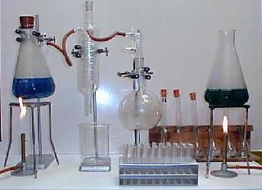
Experimental control
Independent variable (factor)
Dependent variable
Manipulated
To confirm a theory
To explore a relationship
To evaluate model accuracy
To validate a measure
Measured
Causal
effects
established
and controlled
Notes:
Theory – by 4 months of age infants can learn the property of object unity
Exploring a relationship – track relationship between lung cancer rate and level of smoking
Evaluate model accuracy – given a time series model such y(t)=3*y(t-1)+1.1y(t-2)+12 track the mean absolute error
Validate a measure – Does Precision accurately capture the performance of a forecasting algorithm?

Slide 6
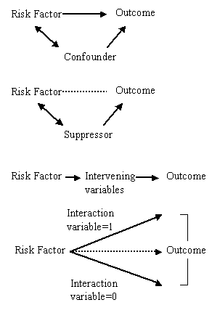
Controlling ‘contaminating’ variables
Confounding variables obscure the effect of the independent variable
Suppressor variables reduce the effect of the independent variable
Extraneous variables – intervening and interaction – are those distinct from the independent variable that may have an effect
Randomisation, blocking and balancing (see later slides) can be used to account for these effects
Notes:
Examples:
Confounding: Age on blood pressure treatment; hardware configuration on benchmarking DBMS software
Suppressor: Poor soil condition reducing the effect of yield gain due to application of fertiliser; the performance gain of an index reduced due to the index being out of sync with the dataset
Extraneous: Intervening – occupational type intervening between educational level and income;
: Interaction diet type interacting with weight loss and height

Slide 7


Internal and external validity
Internal validity – the validity of the existence of the cause and effect relationship
External validity – the validity of the results found in the laboratory setting in terms of the degree to which they can be generalised to other settings

Slide 8

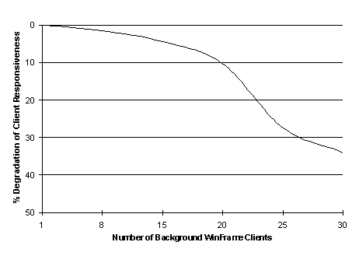

Factors affecting internal validity: history effects
Certain events or factors that have an impact on the relationship between the independent and dependent variables might unexpectedly occur while the experiment is in progress and have an influence on the internal validity
Notes:
Examples:
A heavy snow fall that takes place after a store has announced a sales promotion
Junior school students watch Sesame Street after a reading pre-test has been administered.

Slide 9


Factors affecting internal validity: maturation (order) effects
Cause and effect inferences can be impacted by the effects of the passage of time (and purely the passage of time)
  getting tired
  getting bored
  growing older
Notes:
Getting tired – to investigate the effects of exercise, ask people to walk to work. Some people take a rest in the middle, thus reducing the effect of the exercise
Getting bored – repeating an examination on a topic, but asking different questions each time. Some people get bored with the topic;
Getting older – In a long term study the effects of blood pressure treatment may vary with the age.

Slide 10

Factors affecting internal validity: mortality effects
Subjects who drop out of longitudinal studies may not be randomly distributed among the groups
  Side-effects of experiment

Slide 11
Factors affecting internal validity: testing (learning) effects
Sensitisation through previous testing
Watch also for Hawthorne effect (can lead to use of double-blind approach)
Pre-test
Post-test
Difference
Attributed to the treatment

Slide 12


Factors affecting internal validity: instrumentation effects
Effects might arise because of a change in the measuring instrument between pre-test and post-test
  Finely calibrated instruments
  Observer changing focus
  Pre-test done by experimenter, post-test done by different person

Slide 13


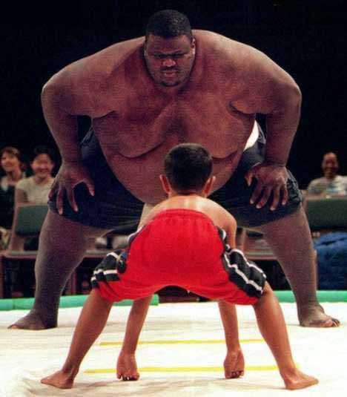

Factors affecting internal validity: selection bias effects
Internal validity can be threatened by improper or unmatched selection of subjects
Subjects may self-select – this can also result in biased outcomes

Slide 14
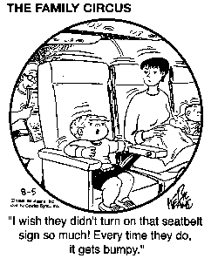
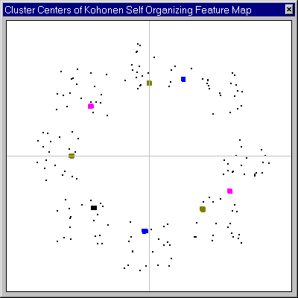
Relationship vs. cause-effect
The existence of a relationship between two variables does not in itself indicate cause and effect
Hence the need to take into account intervening variables
But, some experiments only test for certain types of relationships, so…
The absence of a (specific) relationship does not mean that there is no cause and effect
Notes:
Non linear relationships can exist between the independent variables and the dependent!

Slide 15



Factors affecting external validity
Experimental conditions that do not match the situations to which the results are to be generalised
Inappropriate subject selection or insufficient sample size
Quite simply – the artificial nature of the laboratory environment
Encourages the use of field experiments, but we (generally) sacrifice control
Notes:
Experimental conditions - Isolation of computer network from the internet can distort results.
Inappropriate subject selection - Testing effect of blood pressure treatment on a set of volunteers who are predominantly male.

Slide 16
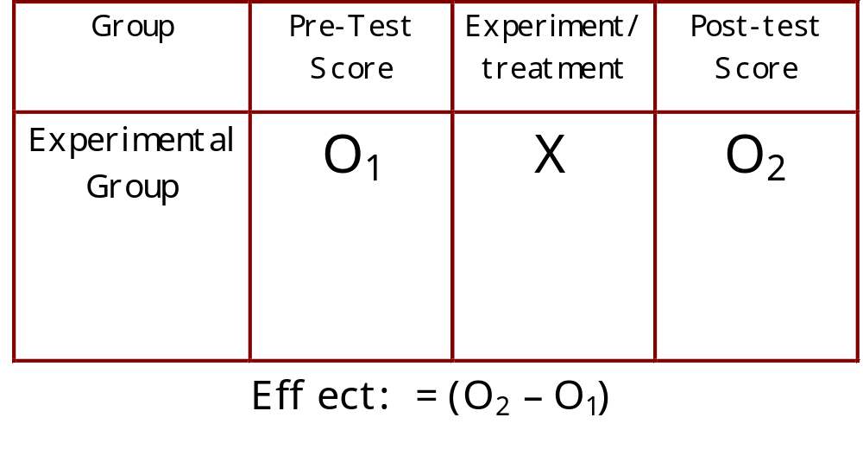
Quasi-experimental designs
Repeated measures:
Pre-test Post-test

Slide 17
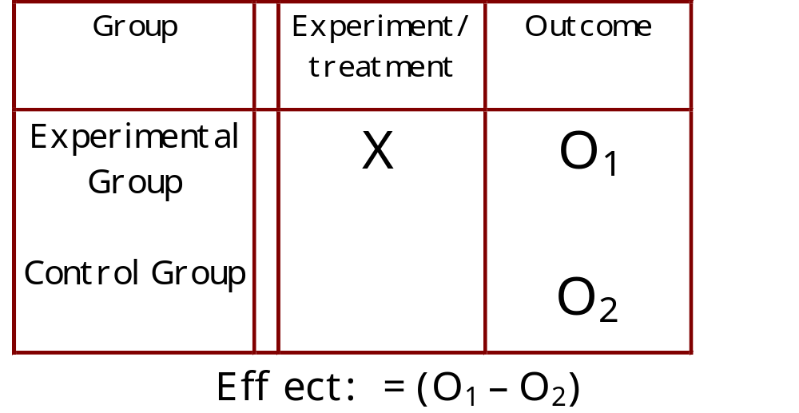
Quasi-experimental designs
Independent-samples:
Post-test with control group

Slide 18
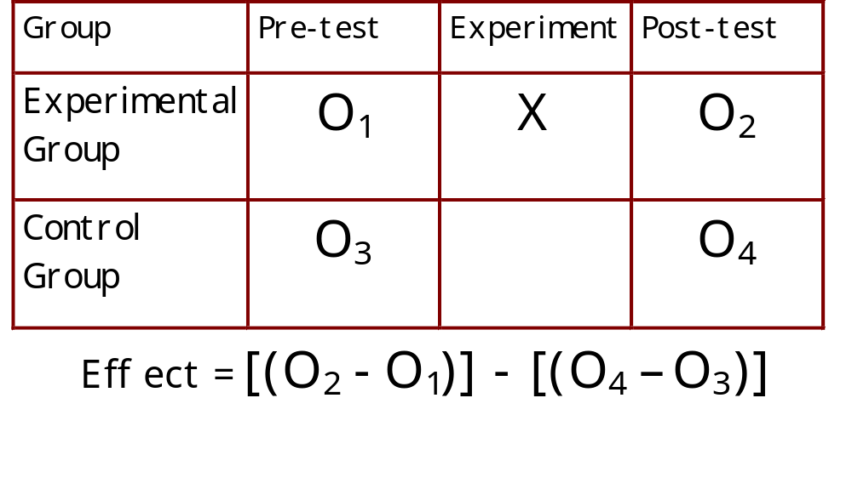
True experimental designs
Post facto

Slide 19
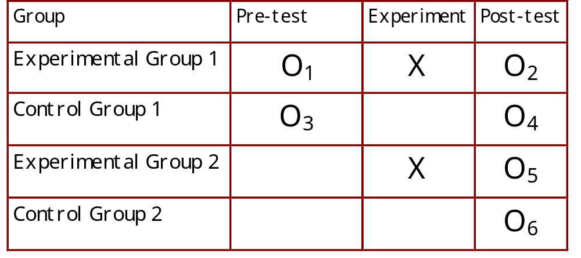
True experimental designs
Solomon Four
Notes:
Complex design. Requires double the number of groups. Advantage is that testing and history effects can be measured, unlike with the other designs
Testing effect = O6-O4

Slide 20
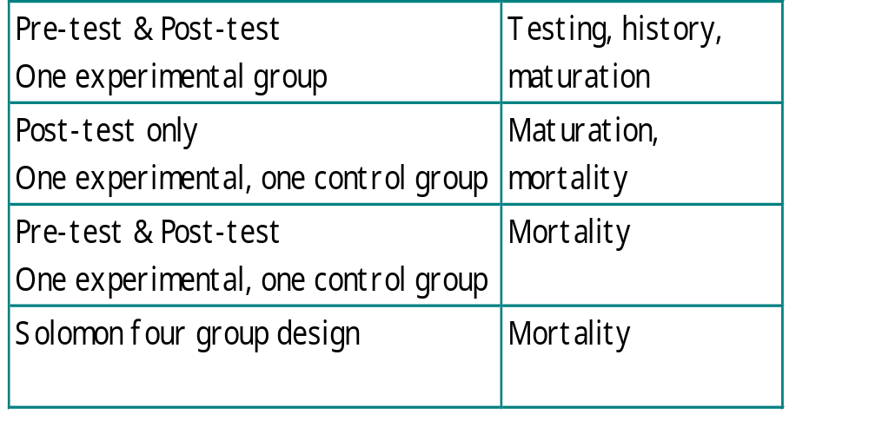
Link between experimental design and threats to internal validity

Slide 21
More Powerful designs
It may be necessary to determine the simultaneous effects of more than one variable on a dependent variable via designs that employ blocking and balancing
Blocking – allocating subjects to groups so the subjects within a block are homogeneous
Balancing – assigning treatments so that an equal number of subjects is assigned to each treatment (simplifies statistical analysis)
Notes:
The designs described before are inadequate when:
Multiple levels of treatment need to be applied.
Control needs to be exercised simultaneously on a number of confounding variables

Slide 22
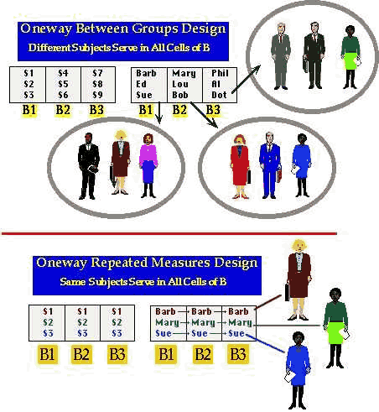
Randomised design
Randomisation – the random assignment of subjects to groups/treatments so that we can assume independence of results
If we use the same subjects in all experimental conditions we have a related repeated measures or within-subjects design
If we use different subjects in different experimental conditions we have an unrelated between-subjects or between-groups design
http://www.wadsworth.com/psychology_d/special_features/ext/workshops/between1.html
Notes:
Related repeated measures design has these advantages: a) Higher statistical validity b) Fewer subjects are needed
Unrelated between-subjects design has the advantage that ordering (testing) effect is eliminated

Slide 23
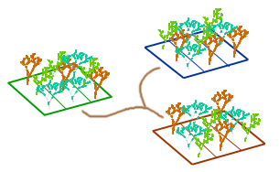
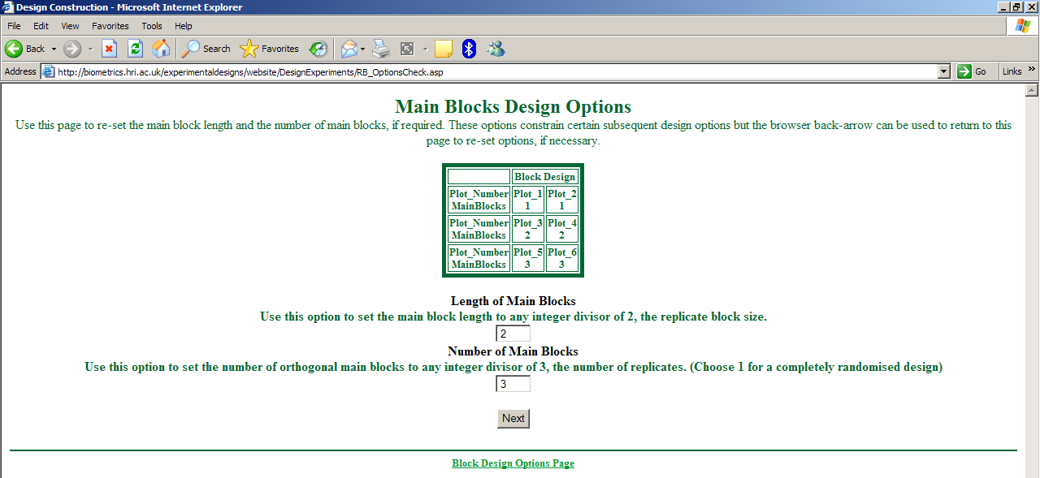
Randomised block design
Blocks are designed so that the predictable variation among subjects in terms of one characteristic is managed by the block effect, thus minimising experimental error
Treatments are then assigned at random to the subjects in each block
Balancing is essential for analysis
Notes:
Used in situations where the experimenter is aware of specific differences among groups of subjects or objects within an experimental group
For example in testing the effect of different skin treatments on people with varying degrees of skin disease, then degree of disease becomes a natural blocking factor

Slide 24
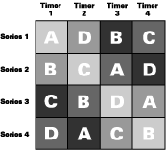


Latin square design
Subjects are blocked with respect to two different variables and then assigned at random to treatments so that each blocking combination is assigned to each treatment
Balancing is essential for analysis
Notes:
Used when more than one blocking factor is involved.

Slide 25
Experiment or case study?
Factor | Experiment | Case study
Level of control | High | Low
Difficulty to control | Low | High
Level of replication | High | Low
Cost of replication | Low | High

